Slide 1
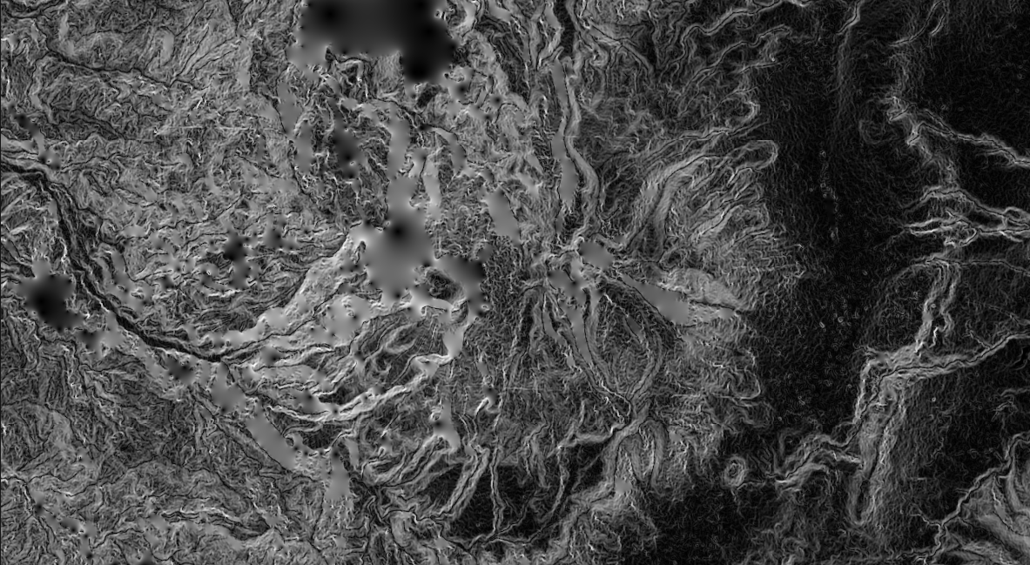
GIS for Geoscientists Lecture 3: Intermediate GIS
Presented by Nicholas Barber, Postdoctoral Researcher at McGill University, QC, Canada.
nicholas.barber2@mcgill.ca | www.volcannick.com | https://github.com/ndb38 | Twitter @volcannick

Slide 2
Course Outline
Tuesday November 1st : Beginner GIS
Course Objectives
Principles of GIS
Tour of the Interface
Projections + Data Types
Managing Layers, Manipulating Data, Designing Your Map
Thursday November 3rd: Exercise #1 - Guagua Pichincha Hazard Assessment
Tuesday November 8th: Intermediate GIS
Getting more out of GIS
Geoprocessing
Spatial Analysis
Data Management
Advanced formatting
Geostatistics
Thursday November 10th: Exercises #2 and #3
Final map assessment due 30/11/22

Slide 3
Supplementary Lectures
Supplementary Lecture #5: Exercise #1 Part 1
Data import, manipulation, and analysis
Supplementary Lecture #6: Exercise #1 Part 2
Layer symbology, Layout Manager, Designing a Map
You can find these on Moodle!

Slide 4
Lecture 1 Review

Slide 5
Finishing Up From Session 2: Corrections + Analysis
Finishing up analyses:
Summarize Population for each census block
Field Calculator
Creation of Hazard Zones
Dissolve
Statistics in a particular Hazard Zone
Statistics Viewer
Layout and Map Making - elements we want:
Main Map
Regional Inset Map
Legend
North Arrow
Scale bar
Grid
Labels for important features
Text box summarizing findings

Slide 6
GIS and Ethics
Critical spatial thinking & unpacking racism and colonialism in GIS

Slide 7
What do we mean by ethics?
Traditional view: involves a judgement of what is right and why, taking into account local and external agendas that frame an issue (Crampton 1995)
Professional ethics is defined by the Royal Institution of Chartered Surveyors (RICS, 2000) as “giving of one’s best to ensure that clients’ interests are properly cared for, but in doing so the wider public interest is also recognized and respected,” (Blakemore and Longhorn 2004).
GIS analyses conducted at the behest of a company or government may not align with concept of an individual's ethical behavior
Thinking about ethics in GIS involves making difficult decisions (Blakemore and Longhorn 2004):
Should I engage in such research if it has both good and potentially harmful outcomes?
What are the ethical dilemmas and potential liability in a government agency making statements about risk and future danger?

Slide 8
Maps are tools, but whose tools?
GIS is inherently tied to public and private power structures e.g., Navy’s development of GPS
Growth in the use of location tracking data and its underlying GIS applications is driven by desire to, “monitor, model, and control consumer behavior,” (Crampton 1995).
If conducting GIS in private sector, use of personal data has been argued to contribute to growth of a “surveillance society,” where individual privacy is not respected (Crampton 1995).

Slide 9
Mapmaking, colonialism, and racism
Development of geology and mapmaking in Britain inexorably tired to colonialism
“As blueprints of its structure, geological maps spread scientific order over the Earth’s surface.” – Stafford (1984)
Expansion of steam powered transportation primarily depended on geological surveys and geological maps (Stafford 1984)
Roderick Murchison (1792-1871) exemplified the union between geology, maps, and imperialism:
President of Geological Society of London between 1831-33 and 1841-43
Pitched government investment in geology in terms of strategic intelligence e.g., Turkish Reforms 1848 (Stafford 1984)
Referred to field work and mapping as “invasions,” or “conquests.”
“Science has never been value-neutral or completely objective; especially in the context of empire, it implies control, both as an instrument of administration and of knowledge.” – Stafford (1984)
How do these historical insights inform our use of GIS today?

Slide 10
Critical spatial thinking
How do we as geoscientists use maps?
What is the goal of making a map?
How do we access data?
Whose permission do we have to use that data?
What decisions do we make when we design a map that perpetuate inequity?
How do we ensure the results of our science have a positive impact on the people concerned?

Slide 11
Critical GIS applied to this course
Exercise #1: What do these analyses not consider? What inequities do they reproduce?
Data was collected from publicly available poster and their work has been cited
Our analysis produces an estimate of exposure to hazard
How were the original data and modeling gathered?
Analysis hinges on census blocks
How does our map actually help the communities affected?

Slide 12
Critical GIS applied to this course
Exercise #1: What do these analyses not consider? What inequities do they reproduce?
Data was collected from publicly available poster and their work has been cited – authors were not contacted or involved in course design
Our analysis produces an estimate of exposure to hazard – assumes homogeneity of population distribution in the area and in population characteristics i.e. what if a particular community is mostly elderly?
How do these communities feel about being classified as in different hazard zones? How does such a classification affect their ability to apply for loans?
How do these communities perceive hazard and risk at G.P.? What right does a white male scientists in the UK have to tell them who is or isn’t at risk?
How were the original data and modeling gathered?
Analysis hinges on census blocks - What inequities exist in Census techniques? Have some communities been undercounted or left out?
How does our map actually help the communities affected? How will the government use our map? What responsibility do we have for their decisions?

Slide 13
Going forward
Ask yourself – what is the impact of my GIS analysis? Am I behaving ethically?
These lessons are fundamental to GIS activities
Ethics underpins everything you do with spatial data!

Slide 14
Intermediate GIS Exercises

Slide 15
New Material Today
Section 2: Advanced Formatting
Line Symbology
Draw Effects
Heatmaps
Raster Viz.
3D Viewer
Section 1: Advanced Analysis
Exercise 2: Fluid Geochemistry of G.P.
Importing CSVs
Spatial Joins
Interpolating Point Shapefiles
Exercise 3: Landslide Risk near Quito
Raster Statistics
Rasterizing a Shapefile
Raster Calculator
Zonal Statistics

Slide 16
Lecture 2, Section 1
Handling Difficult Data Imports, Spatial Joins, Interpolating between Points, Raster Calculator, Spatial Statistics

Slide 17
Outline of Today’s Activity
Exercise #2
We want to know the chemistry of the fluids measured at G.P. Are there hotspots of high SO4 activity?
Requires:
Importing known geochemical data.
Georeferencing 2 new maps
Importing a dataset with no lat/long information
Creating new features
Performing a spatial join
Interpolating to find hotpots
Exercise #3
Landslide Risk example
Importing precipitation data
Calculating Raster Slope
Rasterize rainfall
Use raster calculator

Slide 18
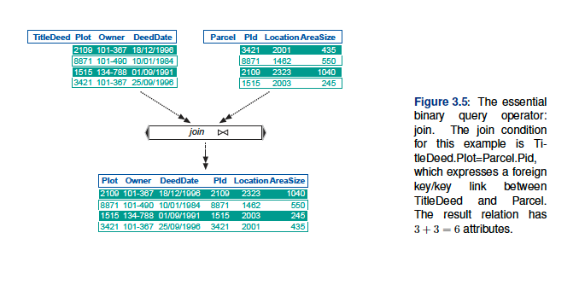
Spatial Joins
Image source: pg. 176 Huisman and de By (2009)

Slide 19
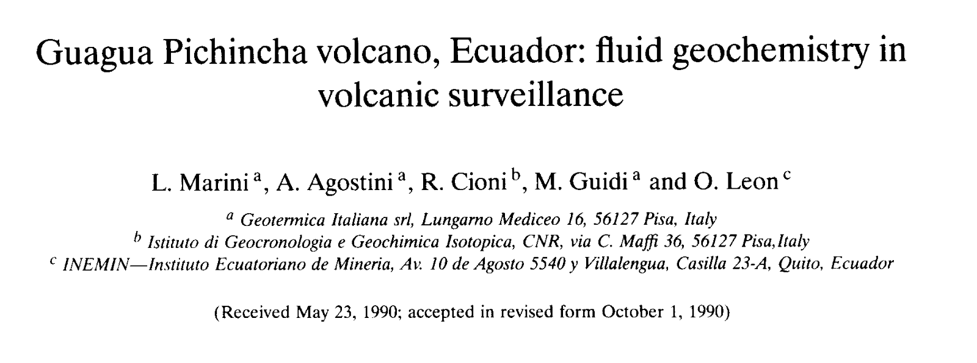
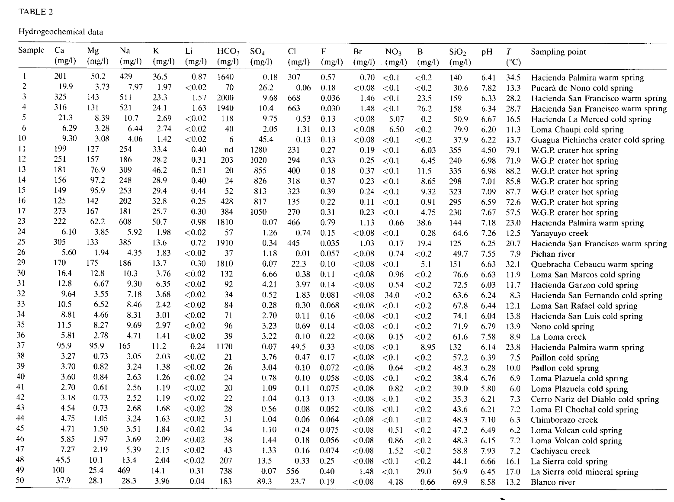

Slide 20
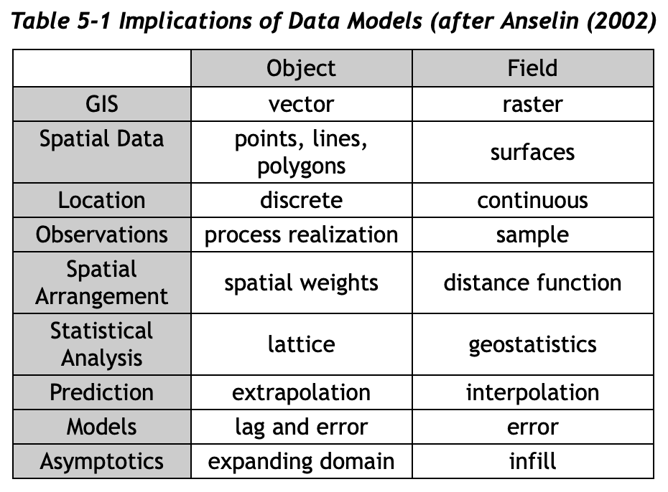
Geostatistics
Free AMAZING resource: https://www.spatialanalysisonline.com/HTML/index.html
One key feature of spatial statistics: because of spatial autocorrelation, data with a spatial dimension violate classical statistical assumption of independence
Independence – in probability theory, occurrence of event does not affect the probability of occurrence of another
Requires different approach to statistics and analysis
Special geostatistical operations: Inverse Distance Weighting (IDW), Kriging, Moran’s I coefficient

Slide 21
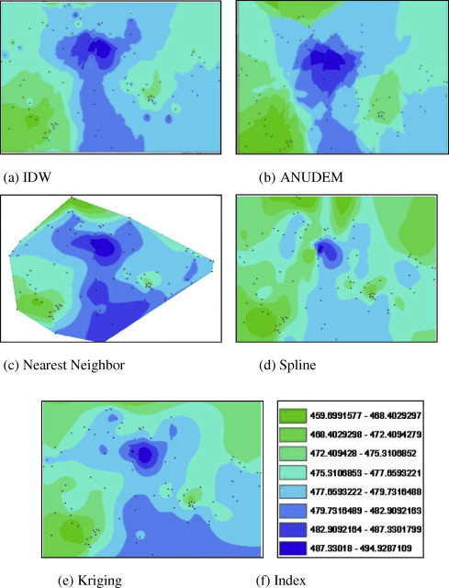
Interpolation
A popular family of geostatistical predictive models
Essentially, generates a surface connecting points.
Surface “height” refers to the difference in some desired value between the spatially heterogeneous points
Deterministic vs. Geostatistical methods offer different user choices, reflecting whether user thinks sample points reflect an underlying statistical sample
Image source: Arun (2013) A comparative analysis of different DEMinterpolation methods

Slide 22
Critical GIS
Do we have a responsibility to communicate these results to Ecuadorian geoscientists/local community?
If we identify a “hotspot” of activity, how can we ensure this message is passed along?
How will our interpolation model affect community perception of hazard, or impact livelihoods of community?

Slide 23
Section 2
Advanced Formatting

Slide 24
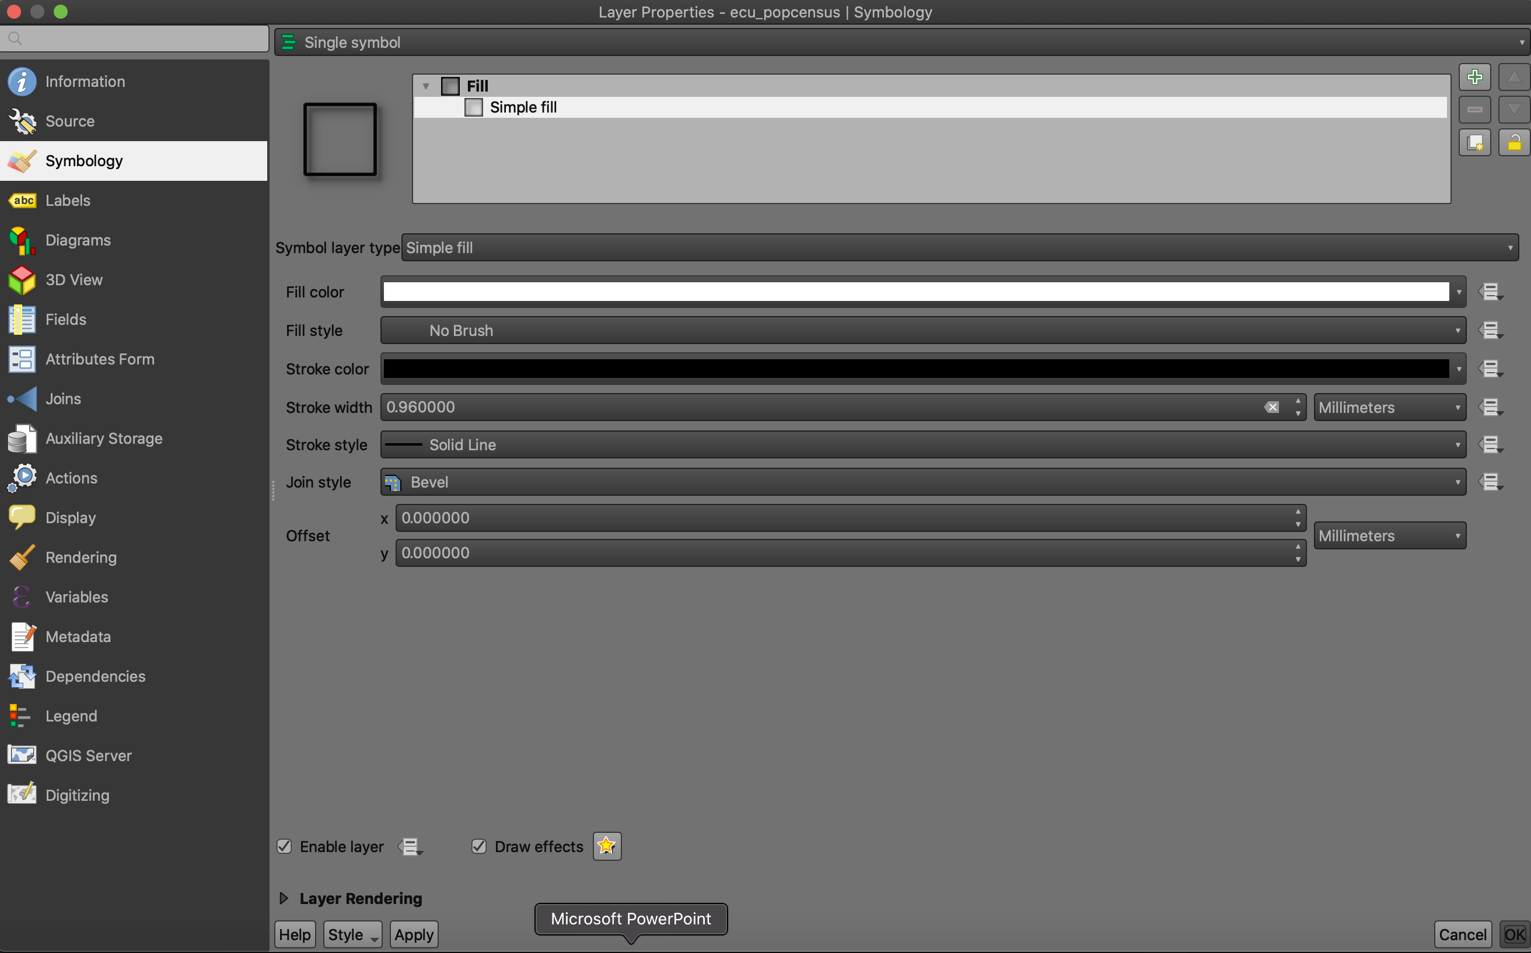
Symbology

Slide 25
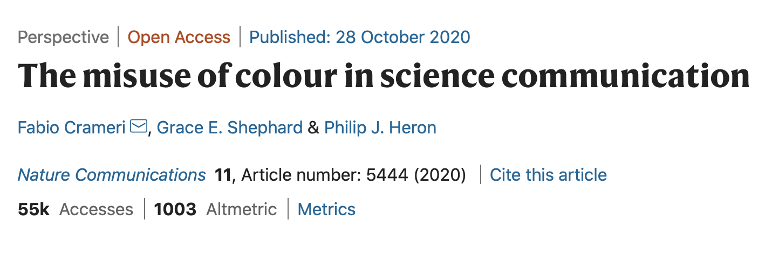
Symbology Advice
Design is an essential element of map making and GIS analysis
The appearance of your data affects how you and others perceive it (Crameri et al. 2020)
Experiment with symbology! When you submit your maps, I want to see different color scales, different polygon textures, different fonts.

Slide 26
Critical GIS
How does our choice of display/symbology/color affect the perception of our results by a diverse community of researchers?
Do our visualization techniques exclude key groups? Obscure underlying complexity?

Slide 27
Advanced Material
Database Connections | Model Builder | Python | Google Earth Engine

Slide 28
What do we mean by “Advanced”
Advanced GIS users concern themselves with a few key problems
Automation: How can I make my computer work for me as I run complex chains of spatial analyses? How do I save myself time?
Reproducibility: How do I replicate the same series of analyses in multiple projects? How do I ensure other people can reproduce my analyses?
Complexity: How do perform multi-staged, conceptually difficult spatial tasks over hundreds to thousands of features?
Visualizations: How do we provide insightful and beautiful visualizations of our spatial data?

Slide 29
Accessing data not on your hard drive
Something I’ve kept from you until now: you don’t always have to download data directly to your machine!
Some GIS files are so common, desirable, or large, it’s not practical to distribute them as downloads
Instead, you can use QGIS’ inbuilt database connections to access remotely-stored datasets
Two use cases that may be relevant in this case:
1) What if all you want is a “basemap” to show the local context of your samples? For example, what if you want to show your points set against a Google Satellite background?
2) You are doing field work in Scotland, and you want a basemap showing the geology of the Scottish Isles set as a backdrop for your work. However, when you go to look on government website’s, they don’t offer a download! How are you supposed to get this basemap?
Answer to both questions: Database connections!

Slide 30
1. Database Connections
XYZ Tiles
Basemaps
WMS
Remote data providers (BGS, USGS, etc.).
WFS
Smithsonian
Difference between WFS and WMS?
WMS imports a map whose underlying features aren’t available for querying
WFS imports features the user can manipulate

Slide 31
2. The Graphical Modeler
When working with a GIS, analytical steps are part of a chain of methods, and these methods aren’t always reproducible. Think about how I’ve taught you up to this point!
Using the graphical modeler, you can wrap chains of operations into a single process, making it convenient to execute later with a different set of inputs, or making it possible to reproduce your method in a different area.
The model you make is executed as a single “tool” in the Processing toolbox, making execution fast and efficient
Spatial indexing!
Citation: https://docs.qgis.org/3.22/en/docs/user_manual/processing/modeler.html

Slide 32


3. Python in QGIS
Can use Python natively in QGIS!
QGIS is actually built on Python
Uses own PyQGIS library with challenging, but accessible, syntax
https://docs.qgis.org/testing/en/docs/pyqgis_developer_cookbook/
Why might we do this?
Automate tasks
Make GIS analyses reproducible
Create your own plugin
Integrate GIS into our regular programming workflow
https://anitagraser.com/pyqgis-101-introduction-to-qgis-python-programming-for-non-programmers/

Slide 33

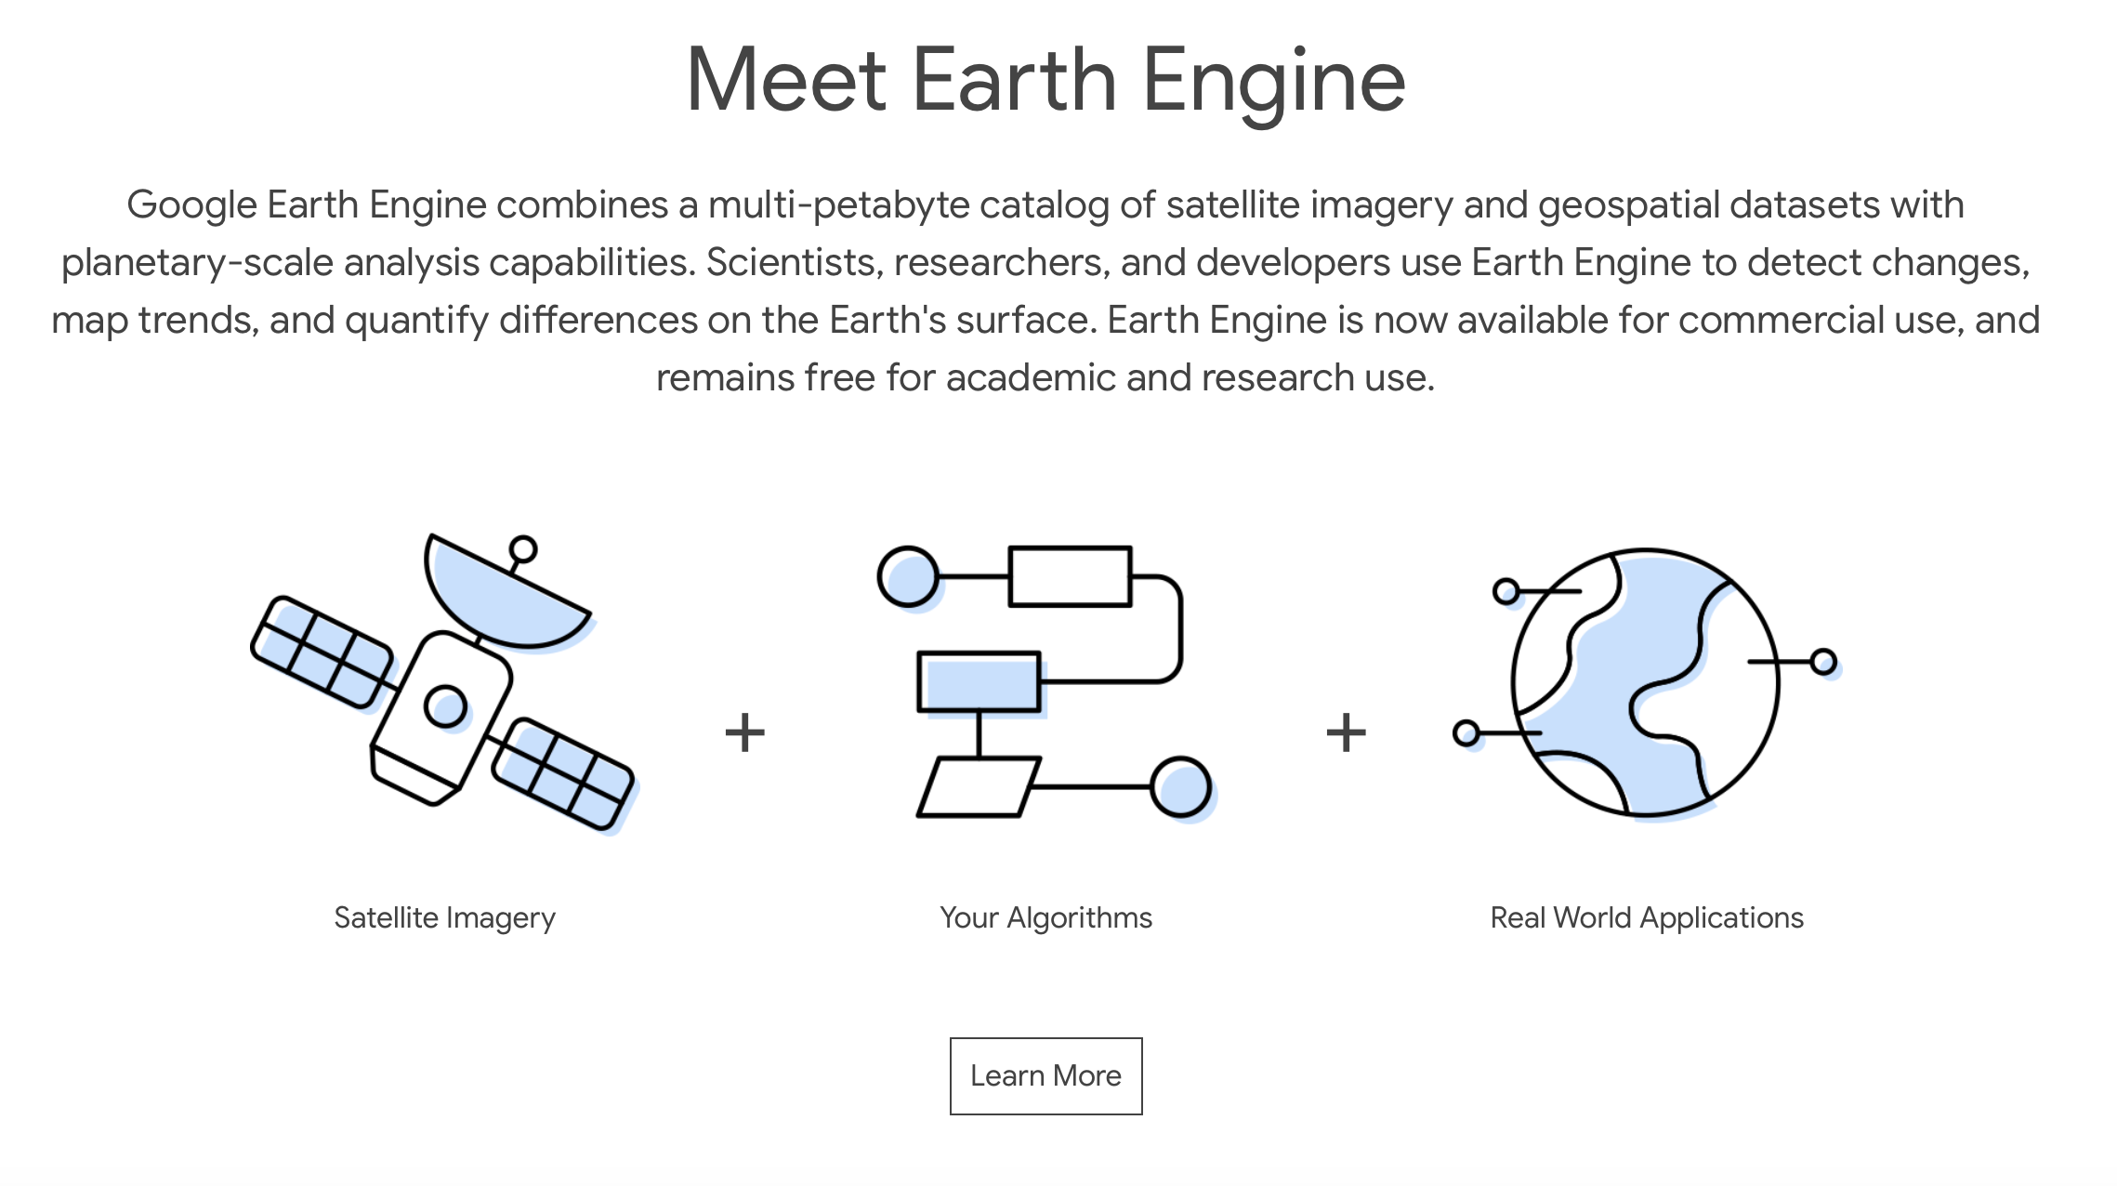
4. Google Earth Engine (GEE)
Google Earth Engine is one of the most exciting developments in modern GIS!
Open-source tool aimed at academic/research community
Used distributed processing to make large operations incredibly fast and efficient
Supports cloud storage, Git, and open-source user development
Setting it up
Applying for Access
Platform
Configuring Python/QGIS
Example in Chrome
Cumulative global rainfall, 2017
Example in QGIS
SRTM 30m resolution

Slide 34
Module Wrap-Up

Slide 35
My goals at the start:
Highlight what GIS can do for geoscientists
Outline the key principles of a geographic information system
Providing a fully guided GIS workflow template
Identify key areas of growth for GIS in geoscience research
Demonstrate relevant GIS applications to undergraduate degree
Interpolation, data manipulation, map design, geostatistics – all of these are tools that may be helpful in your Part III project and beyond!

Slide 36
If you take nothing else away from this workshop….
GIS is a helpful tool in your workflow if you have data with a spatial dimension
GIS software lets you store, collect, analyze, and share spatial data
Modern GIS platforms like ArcMap and QGIS are all around workhorses – essential to tasks like spatial modeling, database management, cartography, geodesy, data visualization, hazard mitigation, and story telling
Learning the capabilities of GIS is acquired from repeated, often frustrating, trial and error with the hundreds of built-in tools
Studies should be designed with the GIS end user in mind!!!

Slide 37
Further Learning
We have only scratched the surface!
Best way to learn QGIS:
Find a project that you are interested in, and that requires QGIS
Use the forums: StackExchange, Documentation, GitHub
Take a break if you are feeling discouraged
Seek out external learning opportunities
Free resources online

Slide 38
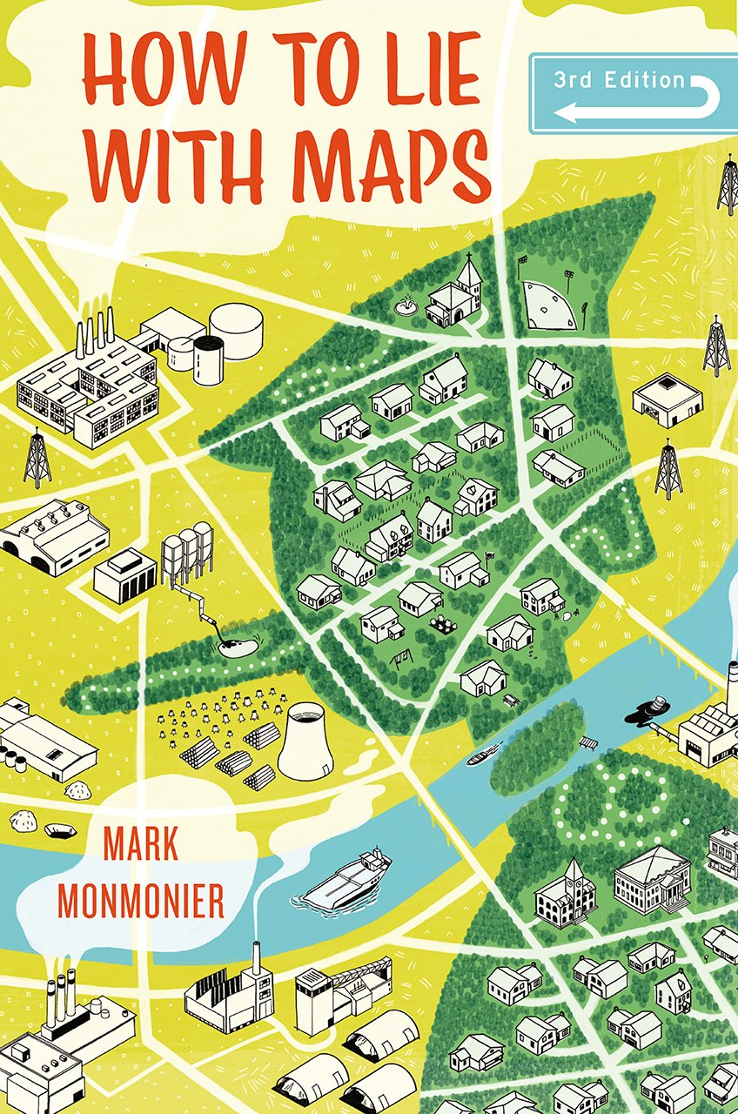


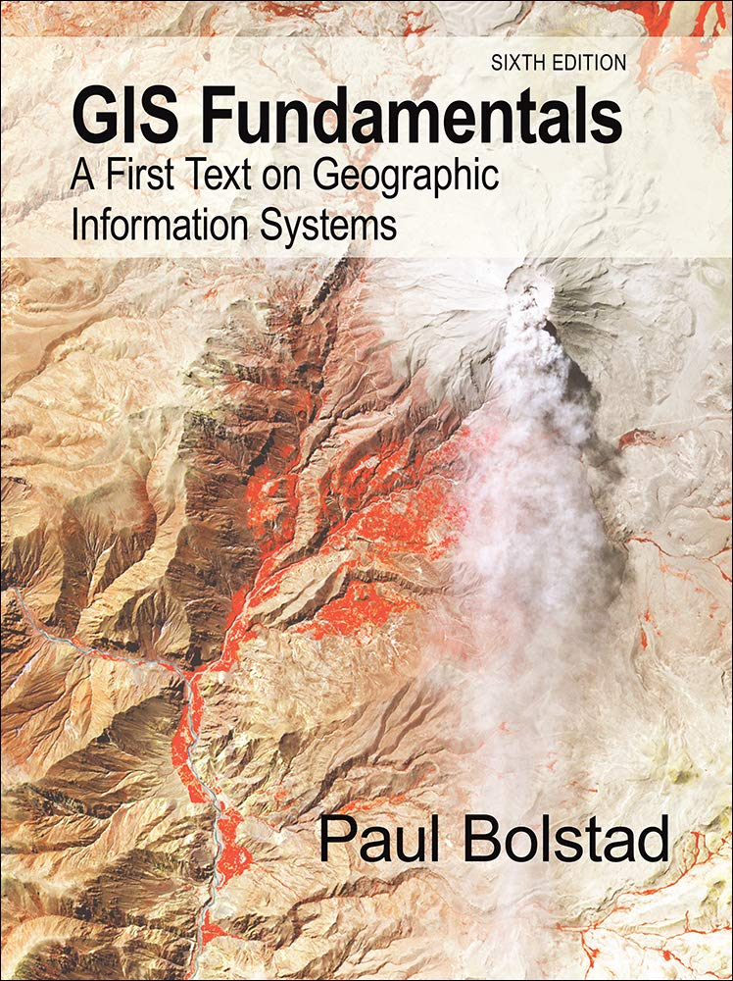
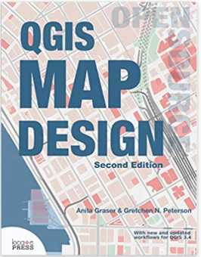
Textbooks
Geospatial Analysis, de Smith (2020): https://www.spatialanalysisonline.com/HTML/index.html
Principles of Geographic Information Systems, Huisman & de By: https://webapps.itc.utwente.nl/librarywww/papers_2009/general/principlesgis.pdf

Slide 39


Slide 40
Thank You ☺ Happy GIS-ing!

